Slide 1
Effective communication of online classes through hand gesture recognition
Team Brnology
Cho Junhee
Kim Kyumin
Elvis Juma
Kim Hyoeun

Slide 2



Communication in online class
-How do you communicate with your teacher?

Slide 3
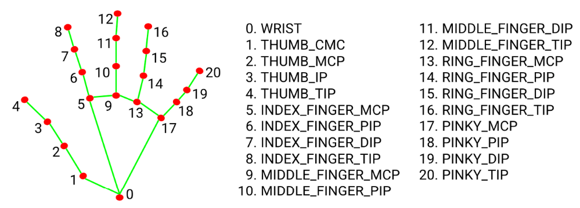

Applied TOOLS
<MediaPipe>, <numpy>, <OpenCV>
Using Machine Learning,
21 3D landmarks are inferred per frame for each hand.

Slide 4
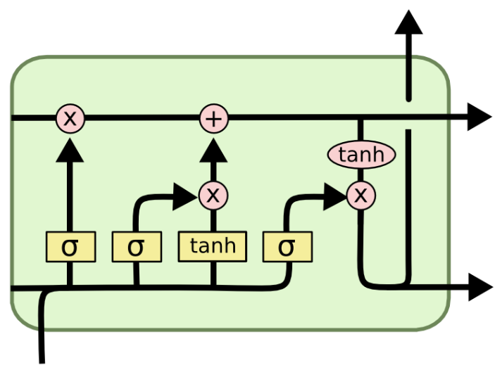
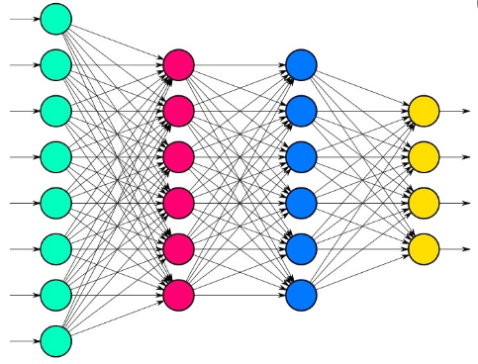
Applied Model
<LSTM>, <Fully Connected Neural network>

Slide 5
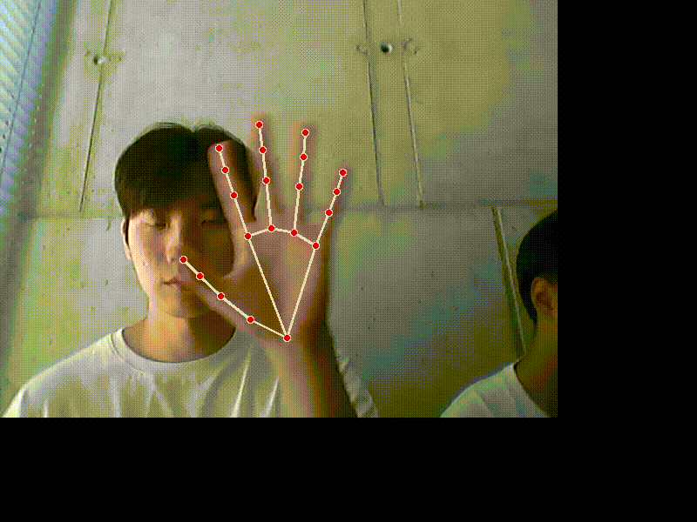
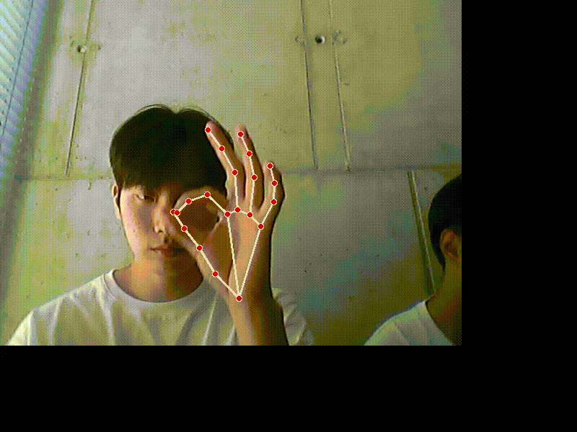
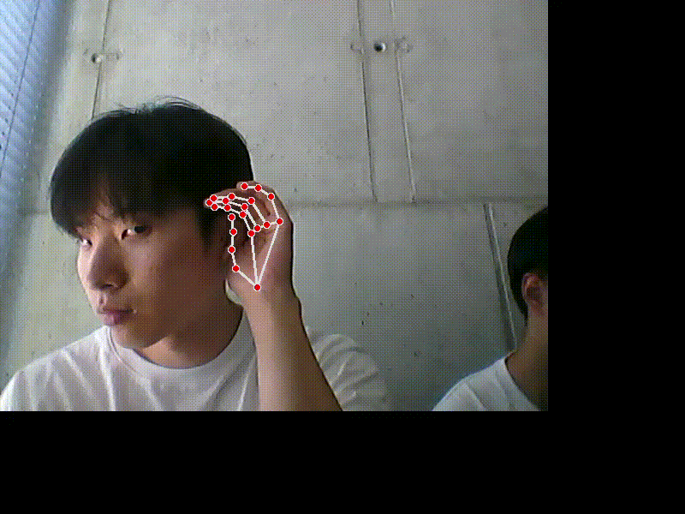
the GESTURE we made
I have a Question
I can’t watch
I can’t listen

Slide 6
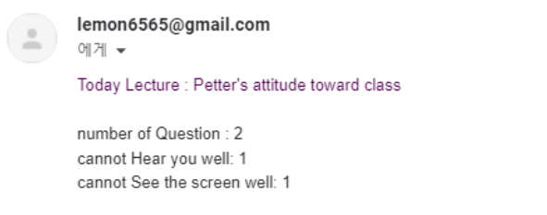
Events that occur after gestures
Send an Email to teacher the result that include
the number of how many times each gesture has been performed.

Slide 7
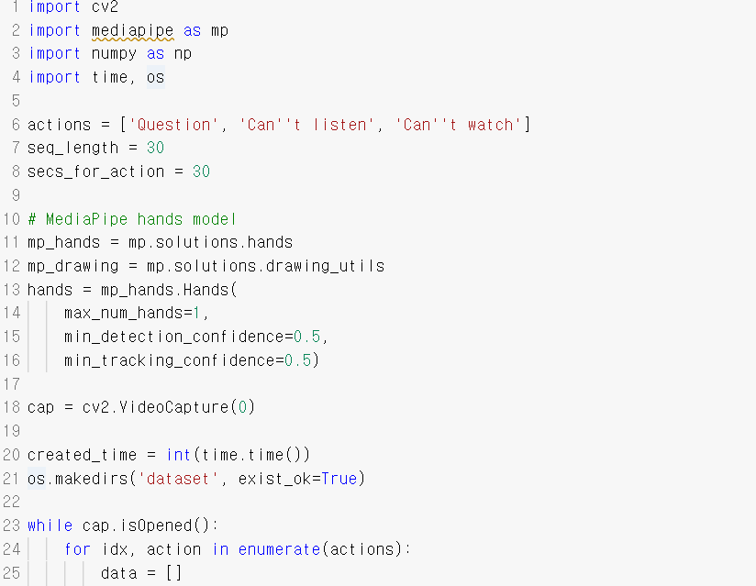
Collecting DATAset

Slide 8
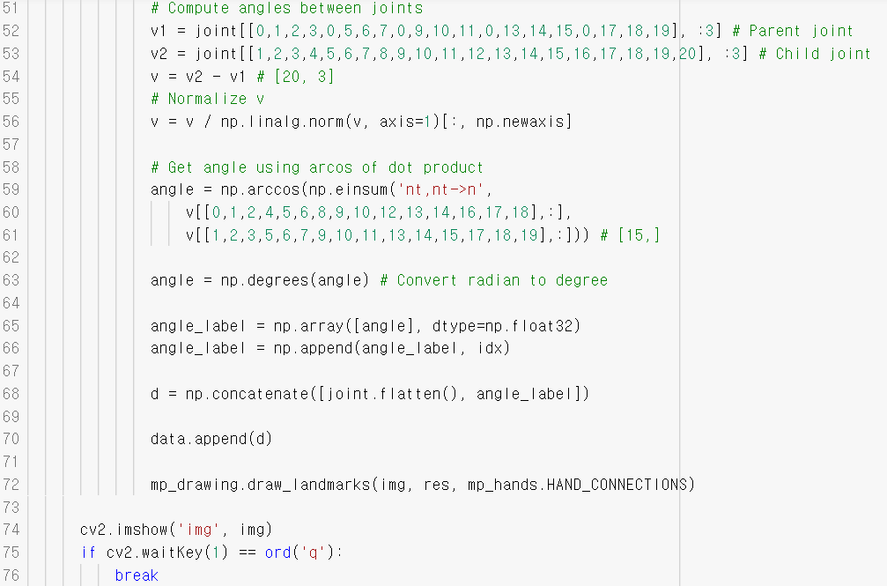
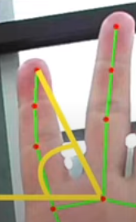
Collecting DATAset

Slide 9
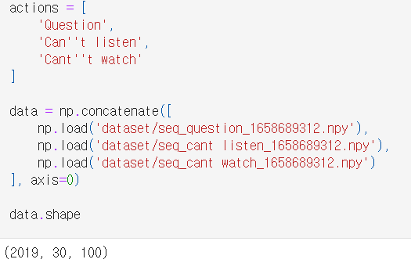
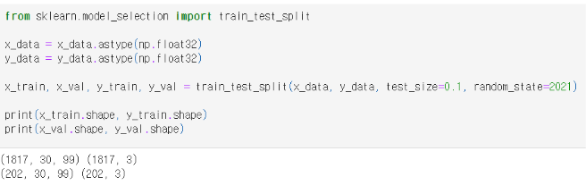
Creating MODEL

Slide 10
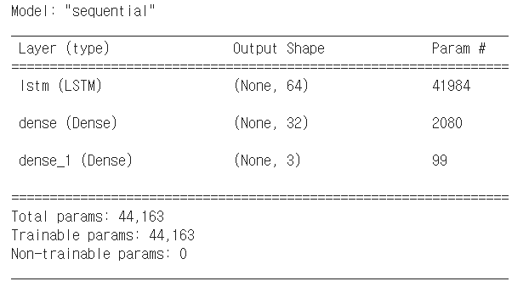
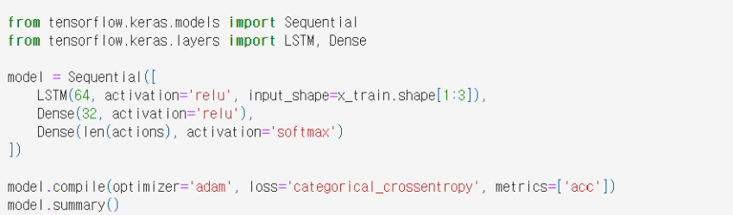
Creating MODEL

Slide 11
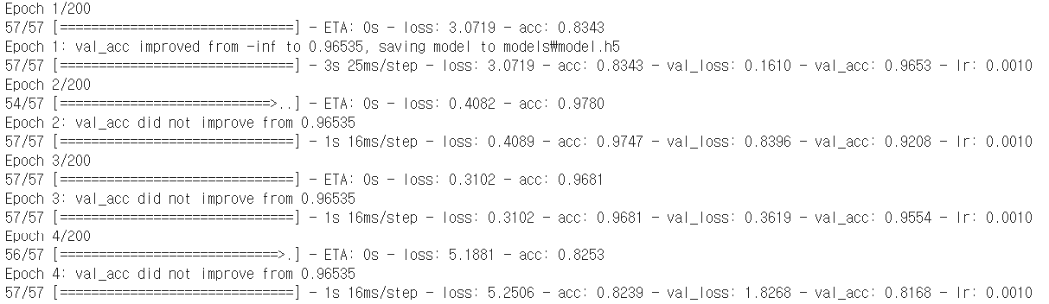
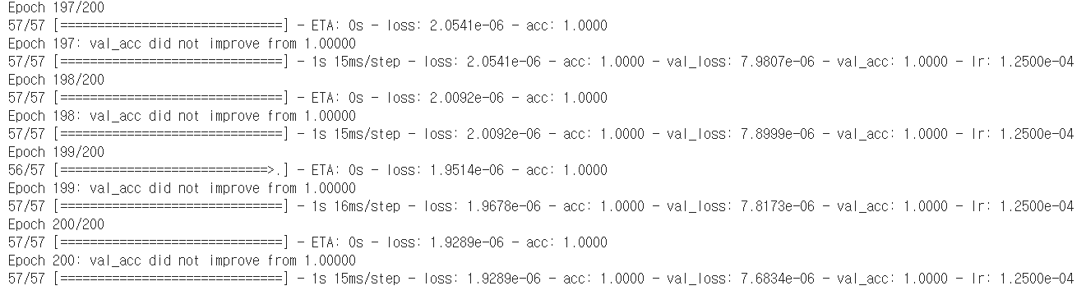
Creating MODEL

Slide 12
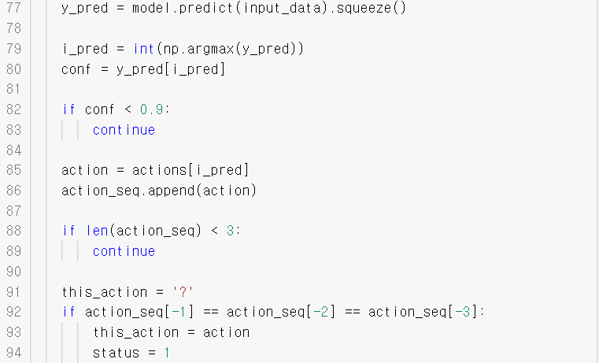
TEST

Slide 13
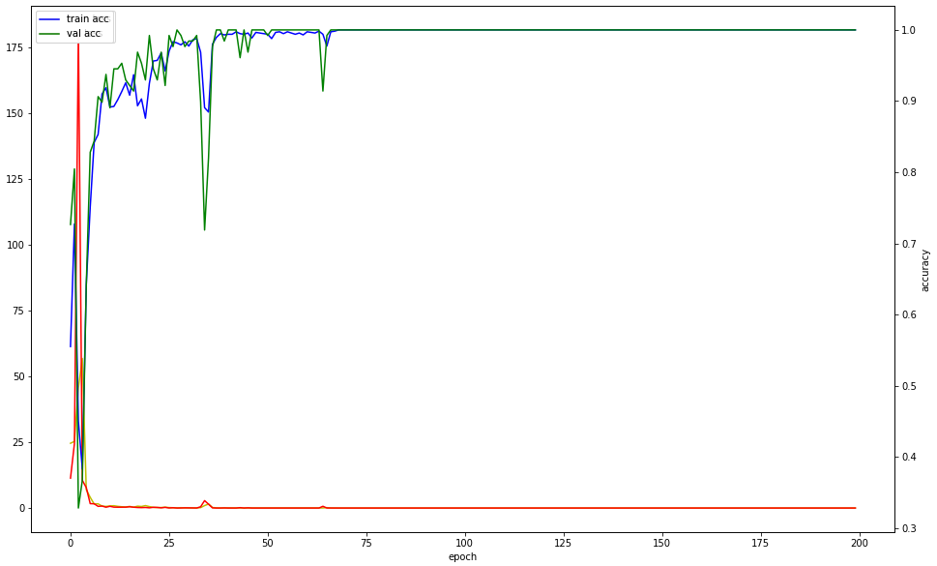
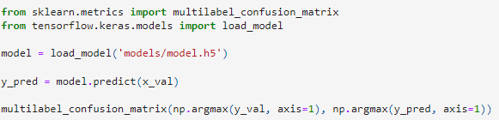
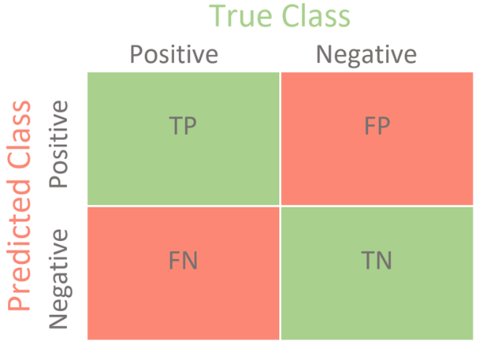
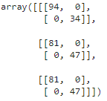
Evaluation Graph

Slide 14
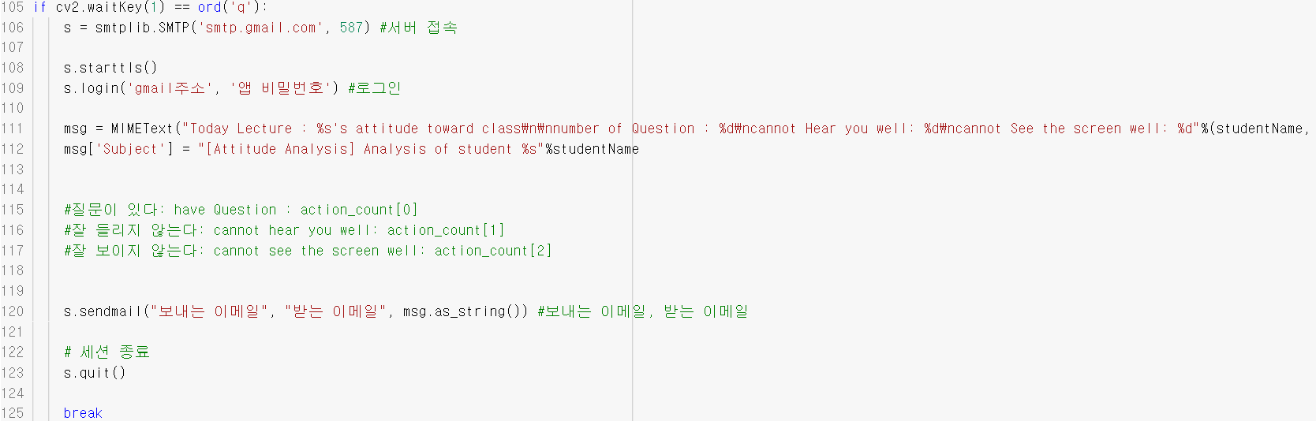
Test

Slide 15
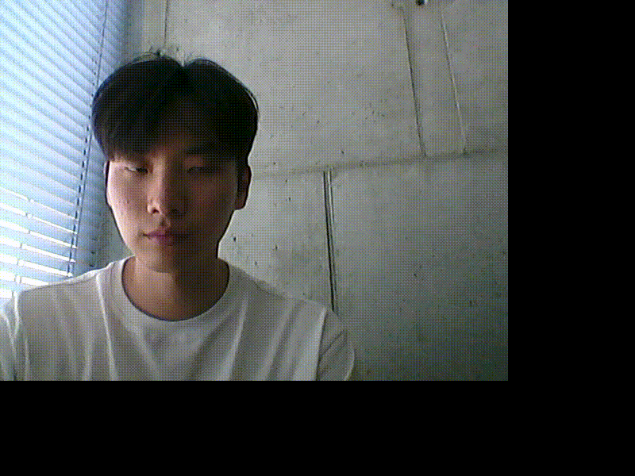
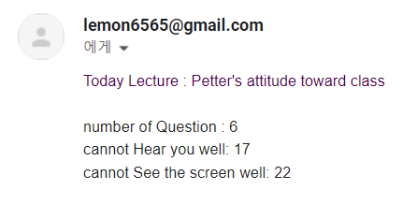
TEST

Slide 16
Thank You

